Slide 1
UNIT-1 (ERM and PAC learning)

Slide 2
Empirical Risk Minimization
Before we get into empirical risk minimization, let us first get an understanding of what is risk.
In supervised learning, we use the dataset that is representative of all the classes for a given problem, to solve the problem.
Let us consider an example of supervised learning problem - cancer diagnosis. Each input has a label 0 (cancer not diagnosed) or 1 (cancer diagnosed).
Since we cannot have a data of all the people in the world, we sample out data of some people to be fed into our model.
We use a loss function to find the difference between the actual diagnosis and the predicted diagnosis.
This is essentially a measurement of error. In machine learning, 'risk' is synonymous to 'error'.

Slide 3
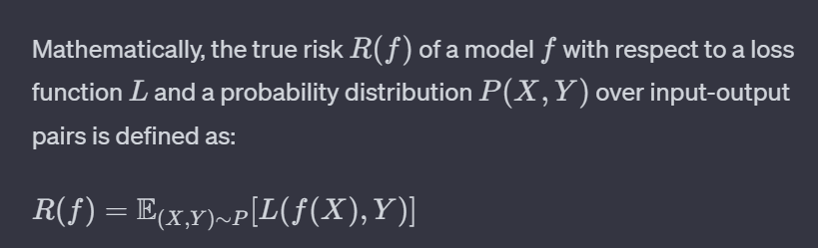
True risk:
True risk (also known as population risk or expected risk) refers to the expected performance of a machine learning model on an entire population of data.
It represents the average loss over all possible data points that the model might encounter. However, in practice, it is often impractical or impossible to evaluate the true risk because we may not have access to the entire population of data.
E(X,Y)∼P​: Denotes the expected value, or average, over all possible samples (X,Y) from the distribution P.

Slide 4
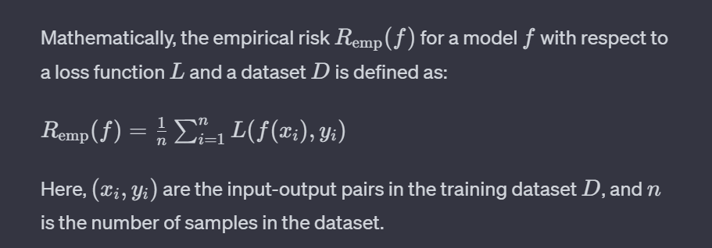
Empirical risk:
Empirical risk is the average loss of a model over a specific dataset, often referred to as the training dataset.
It is a sample-based approximation of the true risk and is calculated using the observed data. The empirical risk helps us estimate how well a model performs on the training data.

Slide 5
Empirical Risk Minimization is an approach in machine learning where the goal is to find a model that minimizes the empirical risk, which is the average loss over the training dataset. The empirical risk is a measure of how well a model fits the observed training data. The basic idea is that by minimizing the empirical risk, the model will hopefully generalize well to unseen data from the same distribution.

Slide 6
Empirical Risk Minimization
While building our machine learning model, we choose a function that reduces the differences between the actual and the predicted output i.e. empirical risk.
We aim to reduce/minimize the empirical risk as an attempt to minimize the true risk by hoping that the empirical risk is almost the same as the true risk.
Empirical risk minimization depends on four factors:
The size of the dataset - the more data we get, the more the empirical risk approaches the true risk.
The complexity of the true distribution - if the underlying distribution is too complex, we might need more data to get a good approximation of it.
The class of functions we consider - the approximation error will be very high if the size of the function is too large.
The loss function - It can cause trouble if the loss function gives very high loss in certain conditions.

Slide 7
Example: ERM in Linear Regression
Let's consider a basic example of linear regression, where the goal is to predict a target variable y based on one feature x. The model assumes a linear relationship between x and y represented by the equation y=mx+b.
1. Dataset: Consider a dataset with pairs of x and y values:
Dataset: D​={(x1​,y1​),(x2​,y2​),…,(xn​,yn​)}​
2. Model: The linear regression model is defined as:
Hypothesis: h(x)​=mx+b​
where m is the slope and b is the intercept.

Slide 8
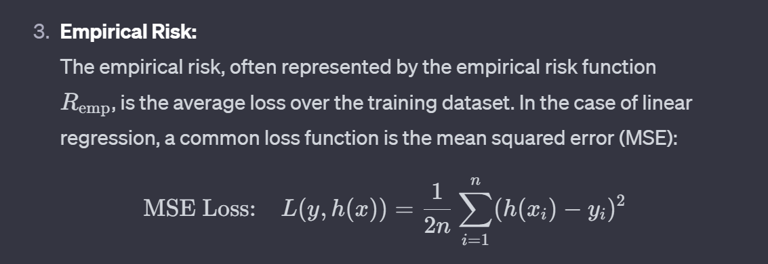
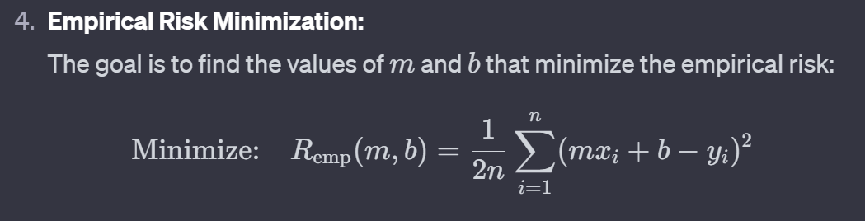

Slide 9
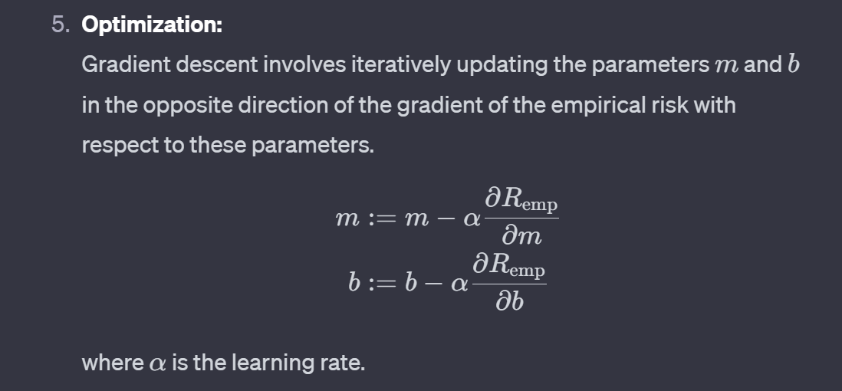

Slide 10
Empirical Risk Minimization with Inductive Bias
Empirical Risk Minimization (ERM):
Imagine you are trying to teach a computer to recognize cats in pictures. To do this, you show the computer a bunch of pictures of cats and tell it, "These are cats." The computer tries to learn from these examples and guess whether a new picture contains a cat.
Empirical Risk Minimization is like training the computer to be really good at recognizing cats based on the examples it has seen. The "risk" here is like how many mistakes the computer makes in recognizing cats in the training pictures. ERM wants to make this "risk" as small as possible, so the computer gets really good at recognizing cats in the training data.
But here's the trick: just because the computer is great at recognizing cats in the training pictures doesn't mean it will be perfect with new pictures it has never seen before. We need to be careful not to make the computer memorize the training pictures (overfitting) but instead learn general things about cats that work in any picture (generalization).

Slide 11
Inductive Bias:
Now, think of inductive bias as the computer's preconceived ideas or assumptions about what makes a cat a cat. For example, if you tell the computer that cats usually have pointy ears and long tails, you're giving it an inductive bias.
Inductive bias helps the computer make educated guesses about cats in new pictures. It's like saying, "Hey computer, pay more attention to pointy ears and long tails when deciding if there's a cat in the picture." This bias guides the learning process and helps the computer generalize better to new, unseen pictures.

Slide 12
Putting it Together:
When you combine Empirical Risk Minimization with Inductive Bias, you're essentially telling the computer to learn from examples (ERM) while also giving it some hints or preferences about what's important to look for (Inductive Bias) when making decisions.
So, in our cat recognition example, ERM would be about making the computer really good at recognizing cats in the training pictures, and the Inductive Bias would be the additional information you provide to help the computer focus on specific features that are likely to be important for recognizing cats.

Slide 13
Inductive bias
ERM can lead to overfitting. Therefore, we seek supplementary conditions that ensure that ERM will not overfit (conditions under which a predictor with good performance on the training data will have good performance on unseen data).
Common solution: Use a restricted hypothesis class H chosen in advance, that is before seeing the data. This approach is known as the inductive bias.
“In simple, Inductive bias is the set of assumptions, beliefs, or constraints that a machine learning algorithm incorporates into its learning process to make it more efficient and effective. It represents the prior knowledge or preconceived notions about the underlying patterns in the data.”

Slide 14
Example:
Let's consider a simple example of Empirical Risk Minimization (ERM) with inductive bias in a binary classification problem. Suppose we want to classify whether a fruit is an apple or not based on two features: color and roundness.
Example:
Dataset: We have a small dataset with labeled examples:
D={(Red,Round,Apple),(Green,Round,Apple),(Yellow,Oval,Not Apple),(Red,Oval,Not Apple)}
Here, the features are color and roundness, and the target variable is whether it's an apple or not.
Hypothesis: Our hypothesis is a simple linear model:
h(x)=w1​⋅Color+w2​⋅Roundness+b

Slide 15
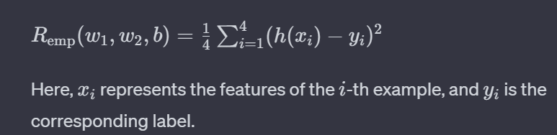
Inductive Bias: Our inductive bias is that color is more important than roundness in determining whether it's an apple. Therefore, we give a higher weight to the color feature.
Inductive Bias: w1​>w2​
Empirical Risk: We use the mean squared error (MSE) as our loss function:

Slide 16
PAC Learning
PAC (Probably Approximately Correct) learning is a framework in machine learning that provides a theoretical foundation for analyzing the generalization ability of learning algorithms.
The PAC learning framework is concerned with the question of whether a learning algorithm can produce a hypothesis that is "probably approximately correct" with high confidence based on a limited set of training examples.

Slide 17
Key concept of PAC learning:
Concept and Hypothesis:
Concept: The true underlying pattern or concept that we want to learn. For example, identifying whether an email is spam or not.
Hypothesis: The hypothesis class consists of all the possible solutions or models the learning algorithm can generate. It represents the space of possible concepts.
Training Data:
The learning algorithm is provided with a set of labeled examples as training data. Each example consists of an input and the correct output, indicating the correct classification or label.
PAC Learning Assumptions:
Sample Complexity (m): The number of training examples needed for the algorithm to learn with high probability.
Computational Complexity (time): The efficiency of the algorithm in terms of computational resources.

Slide 18
4. Probably Approximately Correct:
Probably: The algorithm should output a hypothesis that is correct with high probability, typically denoted by 1−δ, where δ is a small probability (e.g., 0.05).
Approximately Correct: The hypothesis generated by the algorithm should be approximately equal to the true concept with high probability, typically denoted by 1−ε, where ε is a small error rate.
5. PAC Learning Algorithm:
The learning algorithm aims to find a hypothesis that is probably approximately correct based on the training data.

Slide 19
Example:
Suppose we want to predict whether a student will pass or fail an exam based on the number of hours they study. The true concept is the relationship between study hours and exam outcome.
The hypothesis class includes linear models, quadratic models, etc., representing different possible relationships.
The training data consists of examples of students with their study hours and whether they passed or failed.
The PAC learning algorithm analyzes this data to find a hypothesis (e.g., a linear model) that predicts exam outcomes with high probability.
Overall, PAC learning provides a theoretical framework for understanding the trade-off between the amount of training data required, the computational resources needed, and the probability of the learning algorithm producing an approximately correct hypothesis. The goal is to design algorithms that are efficient and provide high-confidence predictions.

Slide 20
Thank you!

